Slide 1
Working with tables
Module 1
Notes:
Workshop Version: 1.4

Slide 2

Module overview
This module covers the following topics:
 | 1 | Tables in Dataverse for Teams
 | 2 | Basic concepts: columns, relationships
 | 3 | Table permissions
 | 4 | Hands-on lab: Setting up basic table and app

Slide 3
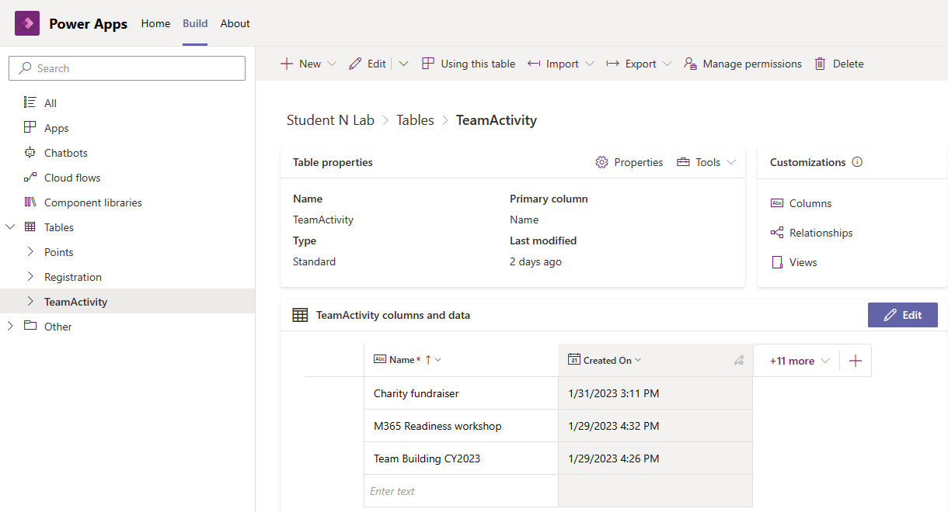
Tables in Dataverse for Teams
Tables are structured arrangements of data, that are stored within Dataverse for Teams environment
Tables can be created and edited using Power Apps app
Same tables can be reused and queried by multiple different apps and flows
Microsoft Confidential
Notes:
‘Entity’ term was used for tables
Each of these tables includes columns that contain data about the subject of the table. For example, a table named Product might have columns that contain a product name, product identifier, manufacturer identifier, and price. Each of these columns can contain different types of data. For example, the type of data for a product name is text, identifiers could be numbers, and so on.
A solution often has multiple tables that are used together in an application. For example, an Order table might reference multiple other tables, such as Customer, Product, and Country. These tables are "related" to one another, and tables provide the way to create those relationships.
You can create and populate these tables with a new visual editor that makes it even easier to work with these tables.

Slide 4
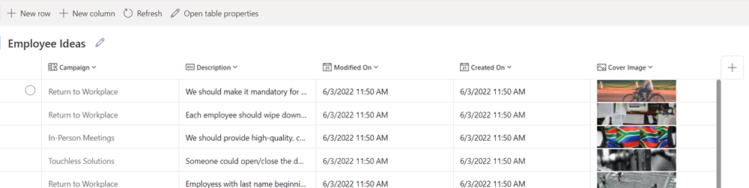
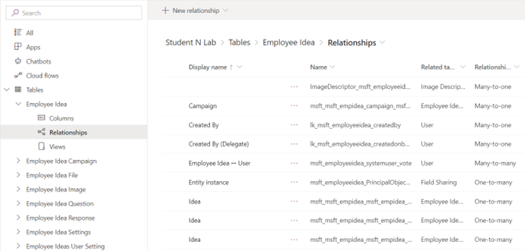
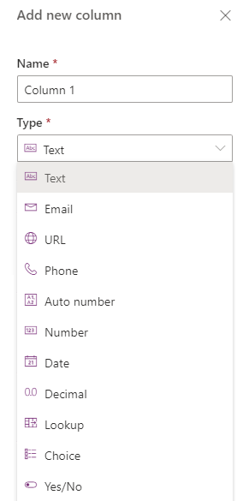
Basic Concepts
Table editor
Columns – define the structure of data and can be of different data types
Relationships – keep data consistent and normalized across multiple tables
Data – content that you create, edit and read from the table
Relationships tab
Column data types
Microsoft Confidential
Notes:
Summary of the tables concepts we discussed earlier.

Slide 5
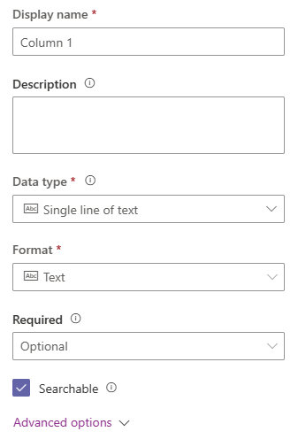
Columns
Table editor
Columns – define the structure of data and can be of different data types
Each column has its data type:
Text types
Numeric types
Date/Time
Choices and Lookups
Tables can be edited in Excel-like table editor interface
Microsoft Confidential
Column data types
Notes:
Demo columns:
Under Build go to Table then choose Columns
Columns when you created tables in Dataverse for Teams.

Slide 6
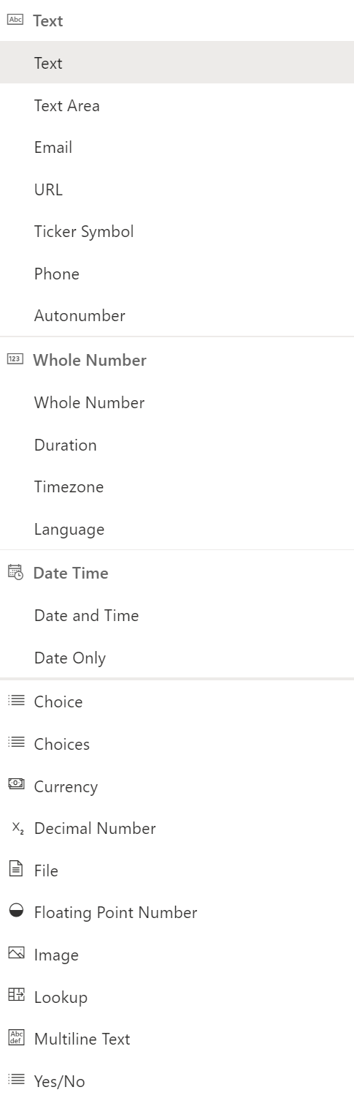
Advanced column properties
Types and formats
Format – each data type supports different formats (e.g., Text -> Email)
Advanced options – various options may become available depending on selected data type and format:
- Min/max numeric values
- Max character count
- and more…
Microsoft Confidential
Notes:
Demo how to check columns data types
Under Build go to Table
Choose Columns
Choose Add columns
Data types. There are 23 data type in Dataverse for Teams. As displayed in screenshot.
Explain that if you want to add a column to an existing table, choose edit data , then added a column that way you will see the data types as displayed in slide text.

Slide 7
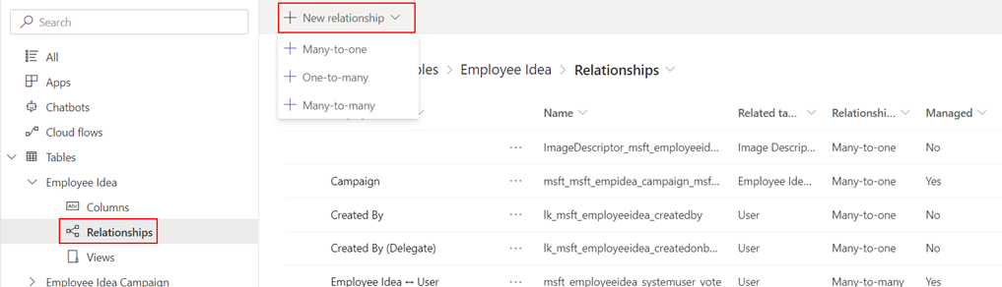
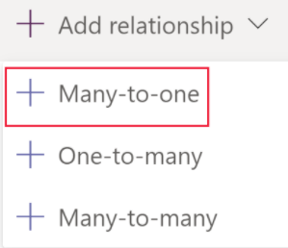
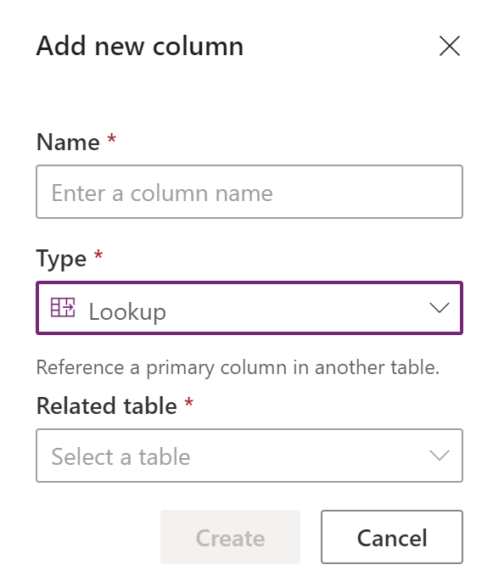
Relationships
Relationships –keep data consistent and normalized across multiple tables
Establish lookups and relationships across any table in the database
Relationships tab
Microsoft Confidential
Notes:
Explain Relationships are to link table together
Demo how to check table relationships and demo the types of relationships.
Under Build go to Table
Choose a table
Relationships
Click on add relationships to demo the types of relationships we have.
Mention to attendees that that in the lab they will work with many to one relationship.

Slide 8
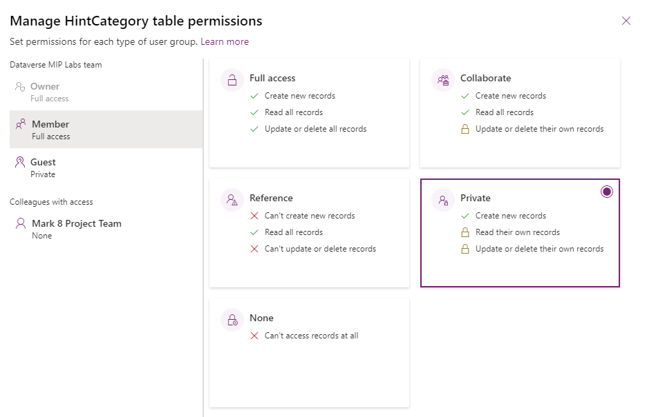
Table Permissions – Members and Guests
By default, Team members are given Full access and guests are given Private access to new custom tables
Permissions:
Full access
Reference
Collaborate
Private
None
Microsoft Confidential
Notes:
To discuss how we can share an app that we built in Dataverse for Teams with users
After installing Power Apps as part of Microsoft Teams
Go to build tab you will see list of the teams that have Dataverse for Teams environment created.
Explain that permission by default and that owner can change the default permission of team members and guests.
Owner have full access by default. That cannot change.
Team members are given Full access. For more security owners can change to other permissions such as private or collaborate
Guests are given Private access to new custom tables so they can see only the record they created. For more security, owners can change this permission too for example to Reference, None, etc.

Slide 9
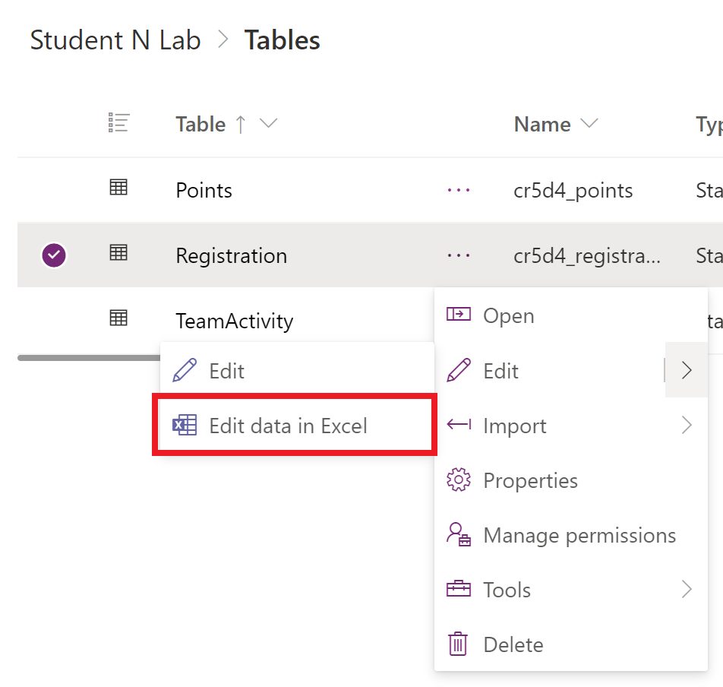
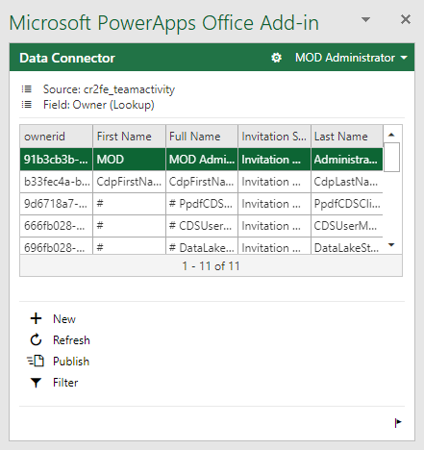
Edit in Excel
With Edit data in Excel, you can quickly and easily view and edit data by using Microsoft Power Apps Excel Add-in
Create new rows or change table data and publish it back by selecting Publish
Update the data at any time by selecting Refresh
Add-in for Microsoft Excel
Microsoft Confidential
Notes:
There are a few issues that can be resolved through some easy steps.
Not all tables support editing and creation of new rows, these tables will open in Excel and allow you to view data but publishing will be disabled.
Look up columns must be edited using the add-in to ensure the correct row is referenced, updating these columns via copy and past or typing directly into the column is not supported.
The maximum table size when editing in Excel is one million cells. If there are too many rows or columns, not all data will be read or published.
Rows are processed sequentially. If there is an error in saving a row, changes to subsequent rows will be aborted. Changes to preceding rows are kept.
Article: Open table data in Excel - Power Apps | Microsoft Docs

Slide 10
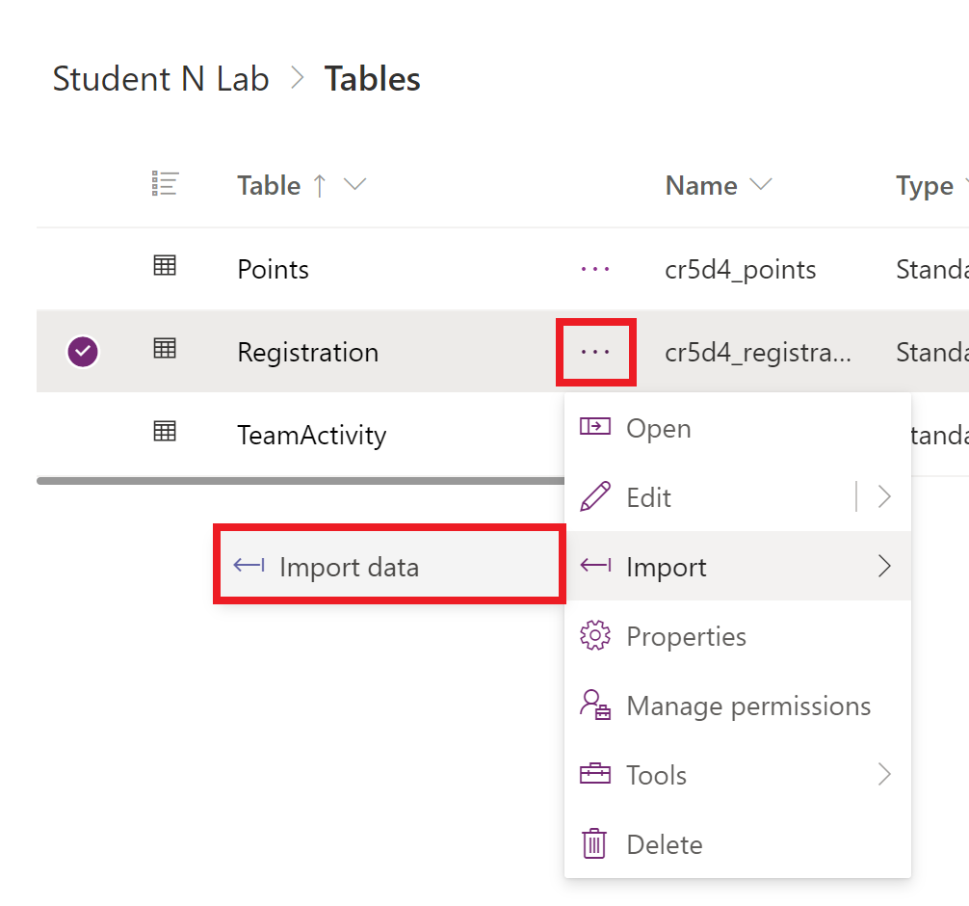
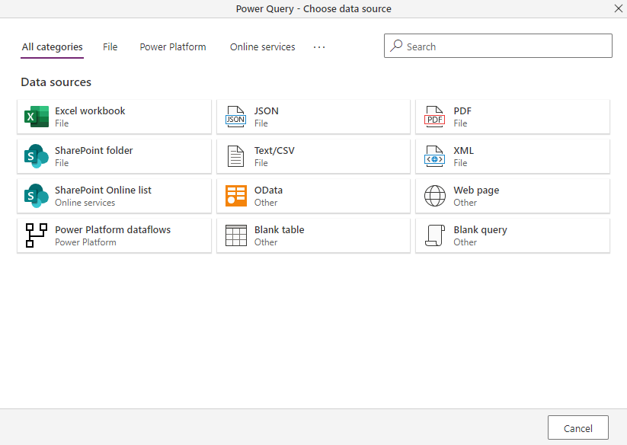
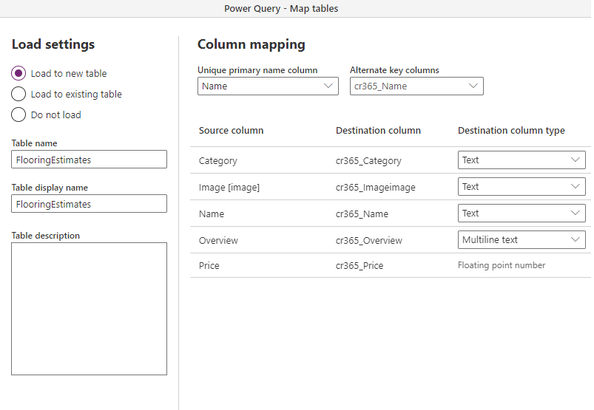
Import data using Dataflows
Dataflows are available for Import in Dataverse for Teams
Choose one of available data sources
Use Power Query to refine data and create a new or map it to the existing Dataverse table
Microsoft Confidential
Notes:
Demo:
Upload Excel file with sample data to OneDrive
Import Excel file with sample data using dataflow
Show a couple of transformations
Map columns to a new or existing table

Slide 11

Lab 1: Setting up basic table and app
Objectives
Create your first table
Create a sample app using table
Send data to table using the app
Never upload your organization data to the lab tenant.
Notes:
Refer to lab 1-0 instructions
##########

Slide 12
Appendix

Slide 13
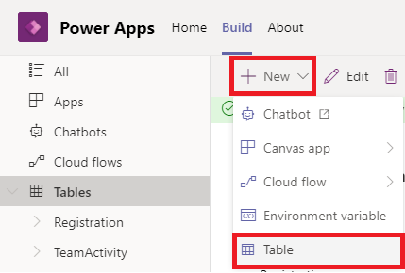
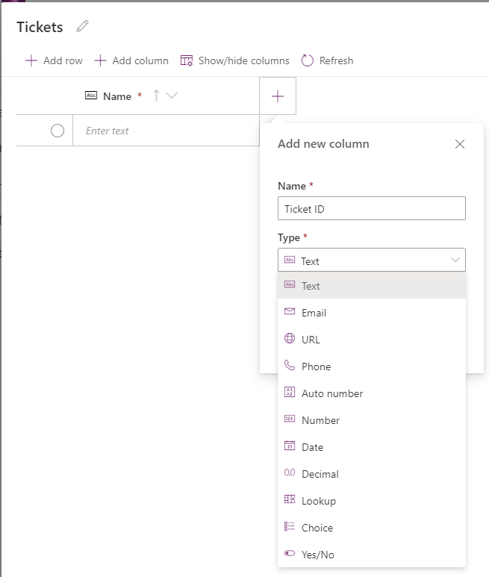
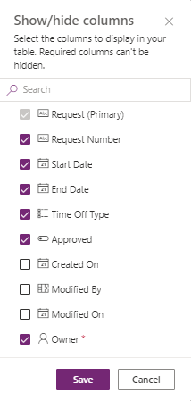
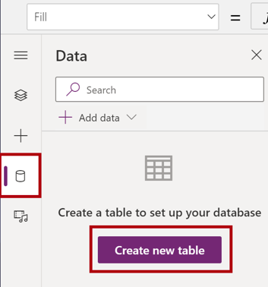
How to create tables?
From Power Apps Teams app
Then use grid interface to edit table structure and add data
Show/hide columns
From Power Apps teams app – Power Apps studio:
Microsoft Confidential
Notes:
Screenshot 2 shows after you create a table a Dataverse for Teams environment is being created for your app
Show/ hide : the list has all the columns that are automatically created you can choose to show them if they are helpful for any app you are building. Note there is an Owner option.

Slide 14
SharePoint Lists vs Dataverse comparison
Considerations | SharePoint Lists | Dataverse for Teams | Dataverse
Number of data types | 15 | 23 | 24
Capacity | Up to 30M rows (considerations for lists > 5k) | Up to 1M rows 2000 API Calls per day per user | No specified limit on rows. 2,000 API Calls per day per user with option of capacity add-ons
Data movement | Create from/Export to Excel | Dataflows In | Dataflows In/Out, data integrations
Security | Owners, Members, Visitors, Customizable permissions | Owner, Member, Guest, Shared With Colleagues roles, pre-defined permission sets | Complex enterprise scenario features: custom roles, business units, auditing, hierarchical/field-Level security, and more
Clients | Lists, Teams, custom code | Teams | Teams, Power Apps, Power Apps portals, Dynamics 365, custom code
Guest limitations | Can't create or delete a list | Can't make, install, or edit apps | Must be in Azure AD using Azure B2B
Pro developer capability | REST API Graph API | N/A | REST API, SDK, Plug-in Support, Data Integrations (Event Hub, Service Bus, Webhook, Export to Lake)
Package and deploy | Package and deploy Lists | Single unmanaged solution per environment | Unlimited
Additional capabilities | Calculations and rollups | N/A | Business workflows, Business rules, Calculations and rollups, Mobile offline
Microsoft Confidential
Notes:
SPO Lists should include additional considerations, when more than 5k items (considerations on querying and list schema changes), more than 20k (considerations on automatic indexing), more than 100k (permission-related considerations). 30M hard limit includes existing version history, if in place.
Full article: Comparing Microsoft Lists, Dataverse for Teams, and Dataverse - Power Apps | Microsoft Docs

Slide 15
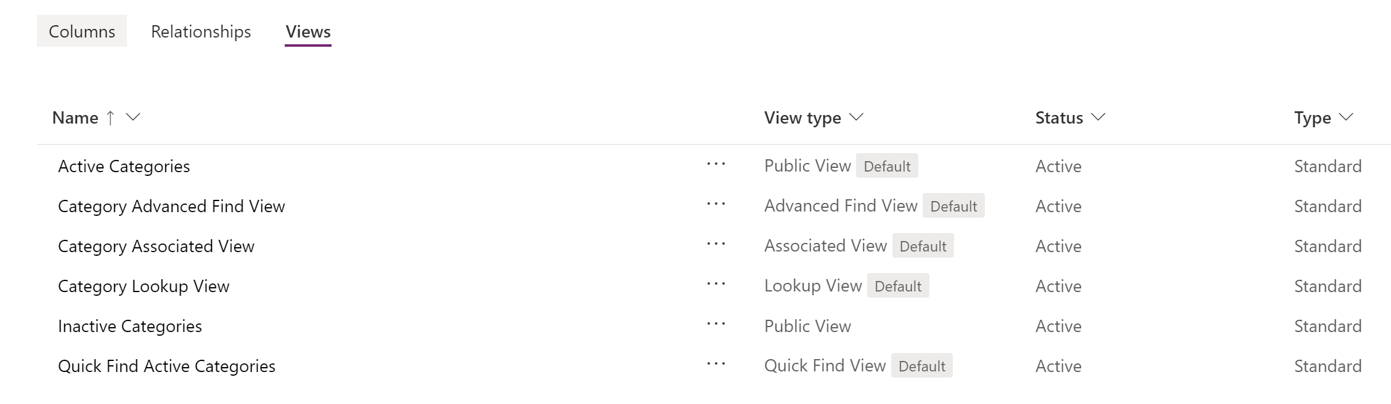
Tables – Views
Views – pre-established data representations, that can be utilized by users and developers
Views can be useful for building optimal delegated queries from apps, flows and other applications
Views tab
Microsoft Confidential

Slide 16
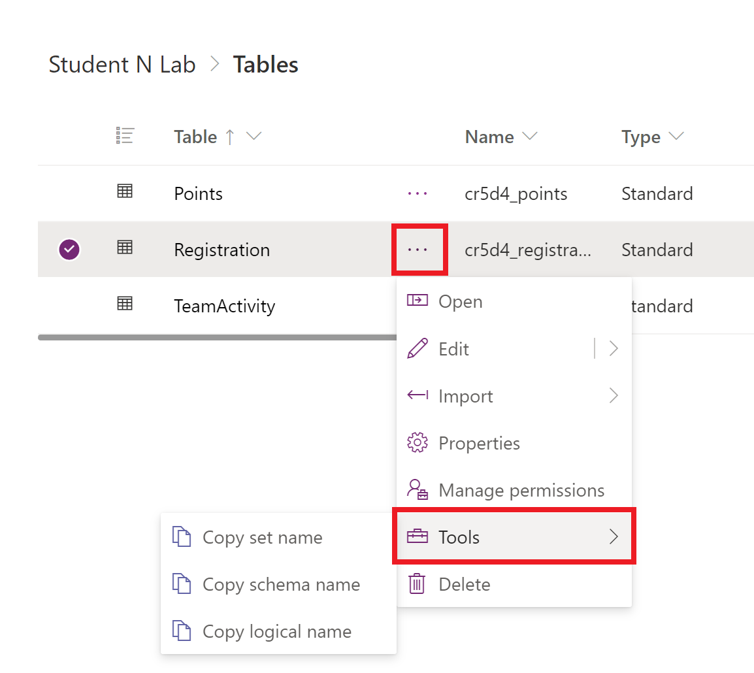
Table tools
You can copy table metadata using context menu.
Table context menu -> Tools:
Copy set name
Copy schema name
Copy logical name
Tools
Microsoft Confidential

Slide 17
Questions?

